Slide 1
“REVELATION”
Series
Introduction
Sermon 2
Reason From
“The Revelation of Jesus Christ, which God gave Him to show His servants-things which must shortly take place. And He sent and signified it by His angel to His servant John” (1:1)

Slide 2

Title
  apokalupsis (to uncover)
Dispensation
  God, Jesus, Angel, John
Timing
  ‘shortly come to pass’
Style
  figurative, not literal
Author
  John (the apostle)

Slide 3
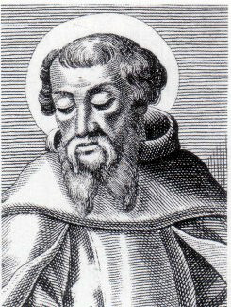
Date: towards the end of Domitian's reign
Irenaeus (130 – 202 AD): “We will not,
however incur the risk of pronouncing
positively as to the name of
Antichrist; for if it were necessary
that the name should be distinctly revealed in this present time, it would have been announced by him who beheld
the apocalyptic vision. For that
was seen no very long time since, but almost in our day, towards the end of Domitian’s reign” (Against Heresies, V, xxx, iii, ANF, I, pp. 559-560.)
REV. 1:1

Slide 4
What Date?
Nero 54-68 A.D.
Galba June 68-January 69 A.D.
Otho January 69-April 69 A.D.
Vitellius April –December 69 A.D.
Vespasian December 69 –June 79 A.D.
Titus 79-81 A.D.
Domitian 81-96 A.D.
Nerva 96-98 A.D.
DATE OF REVELATION

Slide 5
Early Date?
Insisting on the early date (before AD 69, 65-66):
  is done generally by those who interpret the book thematic to the destruction of Jerusalem
The early date proponents:
  must reject Irenaeus’ statement
  must ignore the original recipients of the letter (Rev. 1:4)
    should’ve been written to seven churches in Judea not Asia!

Slide 6
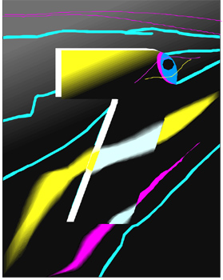
Numbers in Revelation
“7” (completeness)
  most used number
    “seven churches” (1:4)
    “seven lampstands” (1:13)
    “seven stars” (1:16)
    “seven Spirits” (3:1)
    “seven seals (5:1)
    e.g. seven days in a complete week

Slide 7
Numbers in Revelation
“3 ½” (broken, incomplete, finite period of time)
  meaning based on understanding “seven” (Rev. 11:9)
  equivalent expressions:
    42 months (11:2)
    1260 days (11:3)
    time, times and half of time (12:14)
3
1/2

Slide 8

Numbers in Revelation
“10” (fullness)
  “ten commandments”
  “ten days” (Rev. 2:10)
  “ten horns” (Rev. 12:3) 10 = full; horn = power)
  cf. Genesis 31:7; Num. 14:22
“5” (short, incomplete)
  meaning tied to “10”
  “five months” (Rev. 9:5, 10)
“1000”
  meaning tied to “ten” (10X10X10); three-fold fullness
  Rev. 20:2

Slide 9
Numbers In
Revelation
“12” (religion, covenant, government)
  twelve sons of Jacob (Gen. 35:22)
  12:1 “garland of twelve stars”
  21:12, 21:14
“24” (heavenly government)
  “Around the throne were twenty–four thrones, and on the thrones I saw twenty–four elders sitting, clothed in white robes; and they had crowns of gold on their heads” (Rev. 4:4)

Slide 10
Numbers In
Revelation
  “And I heard the number of those who were sealed. One hundred and forty–four thousand of all the tribes of the children of Israel were sealed” (Rev. 7:4)
“144,000” (God’s covenanted people—sealed)
  12 X 12 X 10 X 10 X 10 = 144,000
  (covenant) (3 fold fullness) = ????
  6 X 24 X 10 X 10 X 10 = 144,000
  (man) (3 fold fullness) = ????
(God’s Gov.)

Slide 11
Other Numbers
“1” – unity
  Rev. 17:12, 13; 21:21
“2” – witness, testimony, credibility
  Rev. 11:3; 13:11; 2 Cor. 13:1
“3” – divine perfection, whole
  1 Jn. 5:7; 2 Cor. 12:8; Rev. 8:13; 16:19
“4” – entire, with a beginning, creation
  Job 1:19; Rev.7:1

Slide 12
666
“Here is wisdom. Let him who has understanding calculate the number of the beast, for it is the number of a man: His number is 666” (Rev. 13:18)
  takes understanding to be able to calculate it
  was not intended to be impossible to know
  note: “it is the number of a man”
    not some “superman” but its a human system (the beast) that is against God

Slide 13
Man & SIX
man was created on day six (Gen. 2:26-31)
“Goliath” –defender of false religion
  is mentioned “six” times in the Bible
  was “six” cubits and a span in height (1 Sam. 17:4)
  his spearhead weighed “six” hundred shekels (1 Sam. 17:7)
Nebuchadnezzar –idol builder/worshipper
  made a golden image to be worshipped, “sixty” cubits high and “six” cubits wide (Dan. 3:1ff)

Slide 14
Man & Six
When man elevates himself above God, he always fails!
  IN REVELATION
    sixth seal (6:12-16)
    sixth trumpet (9:13-21)
    sixth bowl (16:12-16)
  three “6’s” represent man elevating himself to a Godlike level and yet unlike God (as in seven, cf. Rev. 3:1) he will always be defeated in such endeavors
    man’s political, cultural, and religious systems that are opposed to God will always result in ruin
    man away from God is ruined!

Slide 15
In The Next Revelation Lesson
Seven Statements From Revelation Defining:
    “The Blessed Man”

